Slide 1

Code search tools
Mihai Todor
11.12.2017

Slide 2
Update
Thanks for answering our call for speakers!
Looking forward to a new year of meetups!

Slide 3

I attended WineConf 2017*
Annual keynote by Alexandre Julliard
Project Hangover: x86 emulation on ARM with Wine+Qemu
OSX removing x86 support
I’m the official distributor of Wine stickers in Ireland ☺
* https://wiki.winehq.org/WineConf2017

Slide 4
How many Windows developers are here?
Notes:
Show Notepad++ example
Show Visual Studio example

Slide 5
Can we do better?
Non-indexed search tools – rest of this talk
Indexed search tools (offline / online)
Visual Studio (Find all references)
Ctags https://en.wikipedia.org/wiki/Ctags
DXR https://dxr.readthedocs.io/
GitHub https://github.com
searchcode https://searchcode.com/
grepcode http://grepcode.com/

Slide 6

Disclaimer: I’m not a console ninja!

Slide 7
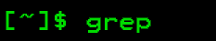
Originally developed for the Unix operating system
Available on most operating systems out of the box
Console-only
Fast
git-grep https://git-scm.com/docs/git-grep
Adopted as a verb / noun: You can't grep dead trees

Slide 8
grep example
grep --include "*.c" --include "*.h" -r -n . -i -e "font"

Slide 9
Shortcomings
Single threaded
Awkward syntax / file type specifications
Inconsistent implementations (Linux vs OSX)
Lacks many features (i.e. non-UTF-8 support)

Slide 10
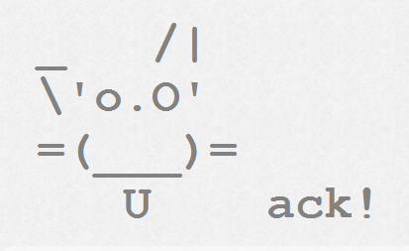
Can we do even better?
https://beyondgrep.com/ (used to be betterthangrep.com)

Slide 11

The Silver Surfer Searcher
https://github.com/ggreer/the_silver_searcher
Written in C
Uses the PCRE library for RegEx searches
Ignores VCS folders and patterns specified in .gitignore / .ignore
Standardisation of the .ignore file https://news.ycombinator.com/item?id=12567328
Example: ag --ignore "./Libraries/**" --cpp -i "font"

Slide 12

Ripgrep
https://github.com/BurntSushi/ripgrep
ripgrep is faster than {grep, ag, git grep, ucg, pt, sift}
http://blog.burntsushi.net/ripgrep/
Written in Rust
Non-UTF-8 support
ag is UTF-8 only https://github.com/ggreer/the_silver_searcher/issues/914
Example: rg -g "\!Libraries/**" --type cpp -i -n "font"

Slide 13

Other alternatives
Sift https://github.com/svent/sift
The Platinum searcher https://github.com/monochromegane/the_platinum_searcher
Even more: https://beyondgrep.com/more-tools/

Slide 14
Limitations
Console only
Can’t click on files to open them in the editor…
Bummer… Too much manual work to open results in editor and scroll to the result line.

Slide 15
IDE Integrations
VSCode search is powered by ripgrep
https://code.visualstudio.com/updates/v1_11#_text-search-improvements
Let’s write a Visual Studio extension!
https://github.com/mihaitodor/Searcher

Slide 16
Any questions?
Thank you!

